Slide 1


VIDEO GAME
SALES
SUBMITTED BY:
HASNAA
DATA ANALYTICS
EXCEL

Slide 2

INTRODUCTION
The video game industry is one of the largest and fastest-growing segments of the global entertainment market.
Video game sales data provides insights into consumer preferences across platforms, genres, and regions.
Analyzing sales trends helps understand which games and publishers perform best worldwide.
Regional sales comparisons highlight market differences between North America, Europe, Japan, and other regions.

Slide 3

OBJECTIVES
To analyze global video game sales across different regions.
To identify top-selling video games, platforms, and genre.
To compare sales performance of major publishers.
To examine the growth pattern of video game sales over time.
To identify regional market leaders in the gaming industry.

Slide 4

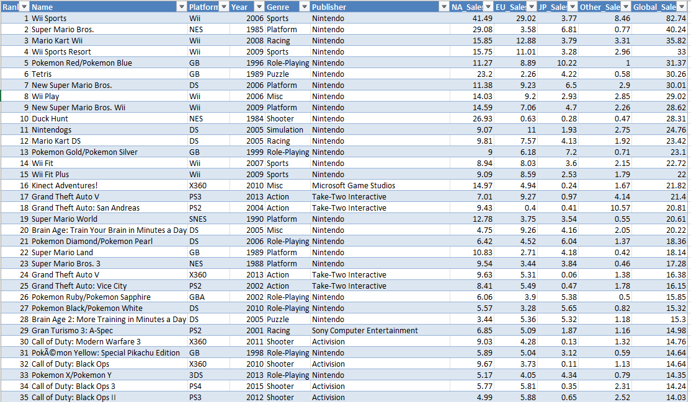
DATASET

Slide 5

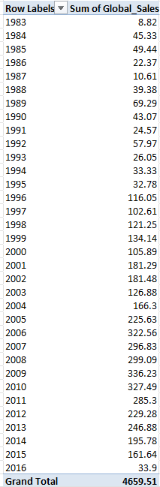
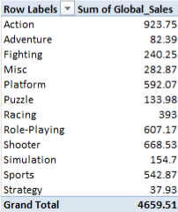
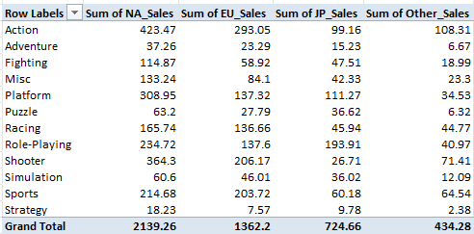

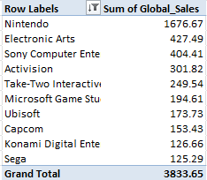
PIVOT TABLES
Global sales trend by year
Global sales by genre
Regional sales by genre
Sales distribution
Top 10 publisher

Slide 6

CRITERIA
Analysis of year-wise trends in global sales performance – line chart
Evaluation of global sales based on genre – 3D bar chart
Top 10 publisher based on global sales – Donut chart
Analysis of region sales distribution across genres – Clustered column
Regional contribution sales – Pie chart

Slide 7
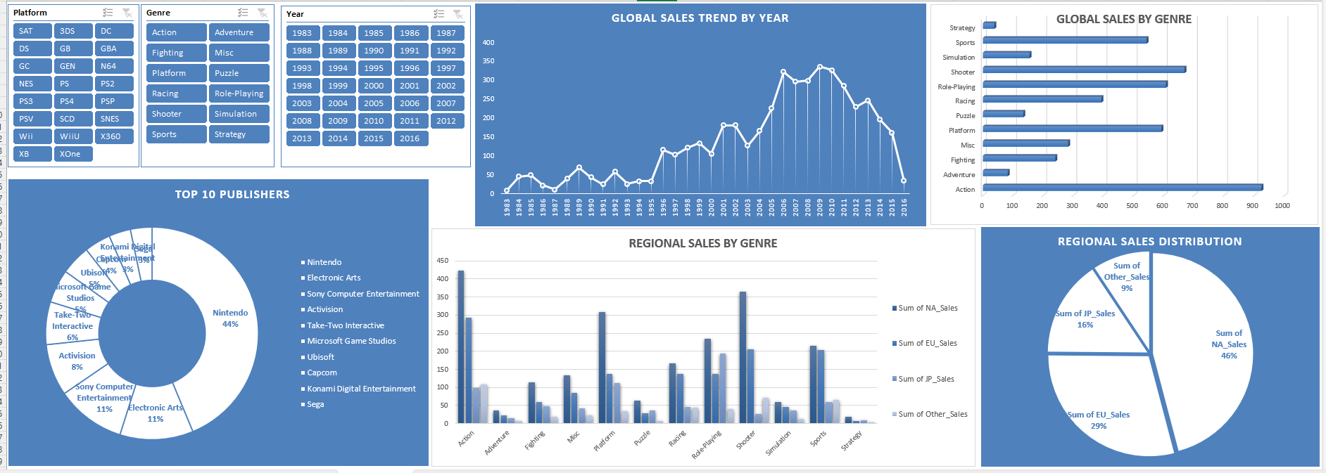
DASHBOARD

Slide 8
CONCLUSION
The video game industry continues to show strong and consistent growth across global markets.
Sales analysis reveals that consoles dominate the market, with action and sports genres leading in popularity.
North America and Europe contributes the largest share of global sales.

Slide 9
REFERENCES
https://www.kaggle.com/datasets/gregorut/videogamesales
Microsoft excel

Slide 10
THANK YOU

